Slide 1
Default Module Version 2
March 2016

Slide 2
Contents
Model Update Overview
Performance Comparison
Detail of Default Model v2
Appendix

Slide 3
Model Update Overview
Update
Data Set
01
Using pool level data instead of loan level to train the regression model;
Calibrate mode using Conventional, Jumbo and CQ/CR data.
Loan Data -> Pool Data
Conventional + Jumbo + CQ + CR
Clearer model structure
Better performance for pool tracking
Update
02
Streamline Model Parameters
Remove 2 sub-models;
Re-structure model parameters;
Remove “tweak function”

Slide 4
Model Update Overview 1. Data Set
Model v1
Calibrated on
Loan Level
For:
Conventional
From:
1999
Purpose of Default Model
Track and predict default speed on:
Pool Level
For:
Conventional
Jumbo
CQ/CR
Model v2
Calibrated on
Pool Level
For:
Conventional
Jumbo
CQ/CR
From:
2011
Longer history | Strength | Pool level model for pool level tracking Calibrate on Jumbo, CQ/CR
Using loan level model to calculate pool level default Not calibrate to Jumbo, CQ/CR data set | Weakness | Limited historical data (Tracking for history is not bad)
Better Meet Model Purpose

Slide 5
Model Update Overview 2. Streamline Model Parameters
Default model V1
Changes
2
1. Change 2 sub-models to 1 parameter
As we use pool level data to calibrate the model, we changed the 2 sub models into one delinquent percentage parameter.
Sub-models
Model for current loans
Model for delinquent loans
2. Remove occupancy parameter
4
From R-square we calculated, occupancy status is not significant for the pool level default data set.
Parameters
3. Add credit availability parameter
CLTV
FICO
WALA
Occupancy
When there is more credit availability, it tend to be easier for borrowers to refinance, instead of default. Add the regression result support a negative correlation between CAI and default rate.
4. Remove adjustment functions
2
The old model involves tweaks because we use loan level data to calibrate model, then try to do tracking for pools.
Adjustment Functions
Tweaks for CLTV, WALA
Decay function for CLTV, WALA
5. Add constraints for extrapolation
Using cap and floors for out of range extrapolation. Make sure the tail performance is reasonable.

Slide 6
Model Update Overview 2. Streamline Model Parameters
Default model v1
Default model v2
2
5
Sub-models
Parameters
Model for current loans
Model for delinquent loans
Delinquent Percentage
CLTV
Credit Availability
FICO
WALA
4
Parameters
CLTV
FICO
WALA
Occupancy
1
Constraint Condition
2
Constraints for extrapolation
Adjustment Functions
Tweaks for CLTV, WALA
Decay function for CLTV, WALA
More Clear Model Structure
Better Tracking Performance

Slide 7
Contents
Model Update Overview
Performance Comparison
Detail of Default Model v2
Appendix

Slide 8
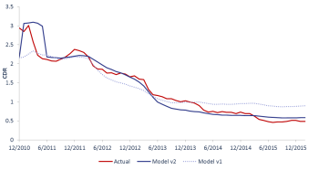
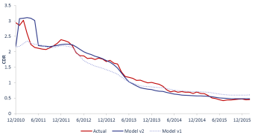
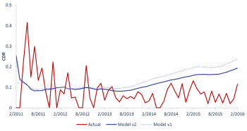
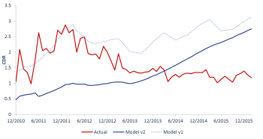
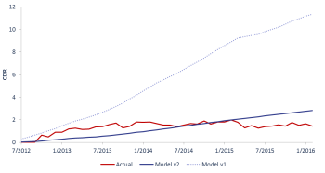
Performance Comparison 1. Overall
Model Tracking Performance – Overall (Conventional + Jumbo + CQ/CR)
Overall
Conventional
Jumbo
CQ
Model v2 has better performance in two areas:
For most recent 2 years, model v1 is too fast, while v2 has better tracking
Model v2 is better capturing the peak in 2011.
CR

Slide 9
Performance Comparison 2. Conventional
Model Tracking Performance – Conventional
Overall
Conventional
Jumbo
CQ
Both of the two models have a good performance for conventional model .
Tracking error for model v2 is smaller especially for the most two years.
CR

Slide 10
Performance Comparison 3. Jumbo
Model Tracking Performance – Jumbo
Overall
Conventional
Jumbo
CQ
Both of the two models have a good performance for .
Tracking error for model v2 is smaller.
CR

Slide 11
Performance Comparison 4. CQ
Model Tracking Performance – CQ
Overall
Conventional
Jumbo
CQ
For CQ pools, both of the models are too fast after 2014, but model v2 is closer to actual in that period. However, Model v1 shows a better performance in 2011/2012.
CR

Slide 12
Performance Comparison 5. CR
Model Tracking Performance – CR
Overall
Conventional
Jumbo
CQ
Model v2 has a much better performance in CR pools compare with model v1.
CR

Slide 13
Performance Comparison 6. Historical Performance
Model Tracking Performance – Historical
Loan Level Actual
Pool Level Actual
In order to exam our model for the historical performance, we use a partial loan level actual default number as benchmark. Result shows even only using data from 2011 to calibrate the model, the v2 model is not worse than v1 for the historical part(1999 to 2011).
And for tracking from2011 to 2016, v2 shows its strength.

Slide 14
Contents
Model Update Overview
Performance Comparison
Detail of Default Model v2
Appendix

Slide 15
Detail of Default Model v2 Model Multipliers
01
Pools with higher delinquent percentage will expect a faster pace of default. As it shows more borrows are in trouble of making payments.
Our default model version 2 includes five predict parameters listed left.
Sequentially fitting model with the five parameters, we can create a cubic spline curve for each one of the inputs.
The order of parameter is based on a single parameter regression calculated R-square value.
Parameters that have earlier order will have more significant impact of our model out put.
Delinquent Percent
02
Borrower with higher CLTV will have a higher risk of default. Especially for CLTV close or higher than 100 loans.
CLTV
03
When credit availability goes higher, borrowers will have a better chance to refinance, which in case lower the default rate.
Credit Availability
04
Borrowers with lower FICO score will have higher risk of default.
FICO
05
The WALA ramp effect shows a increasing trend of default with loan age goes up.
WALA

Slide 16
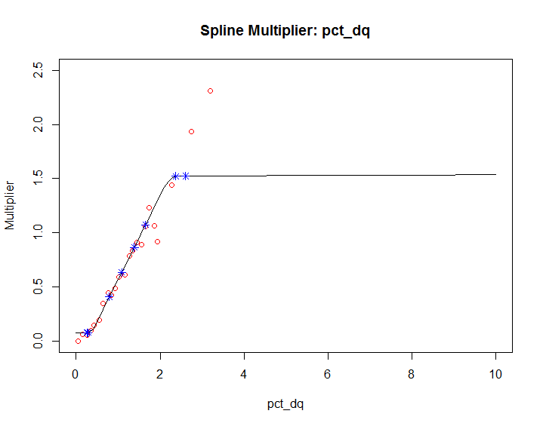
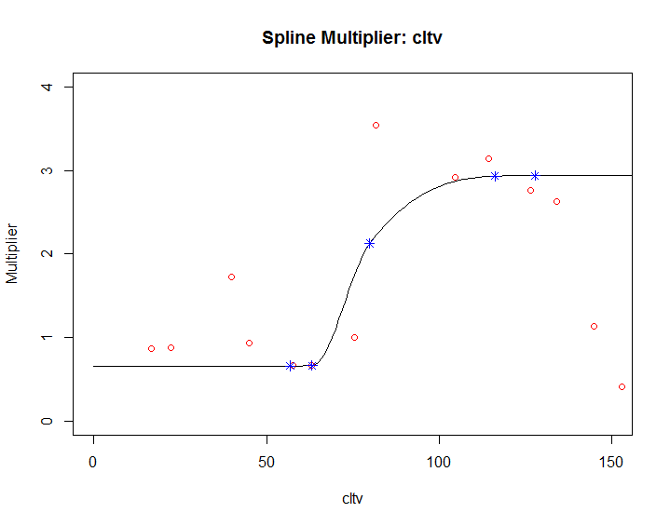
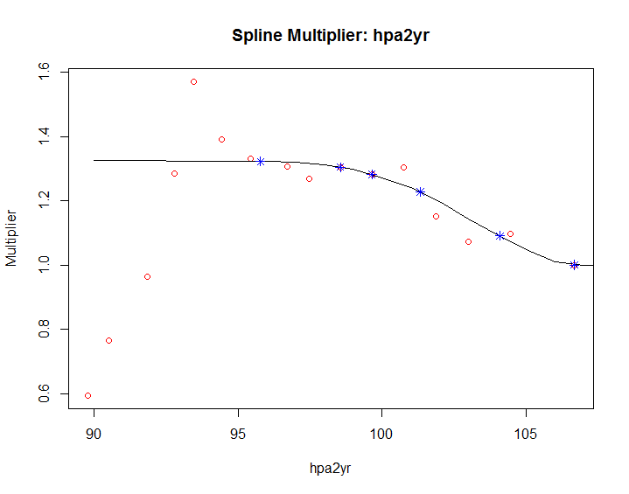
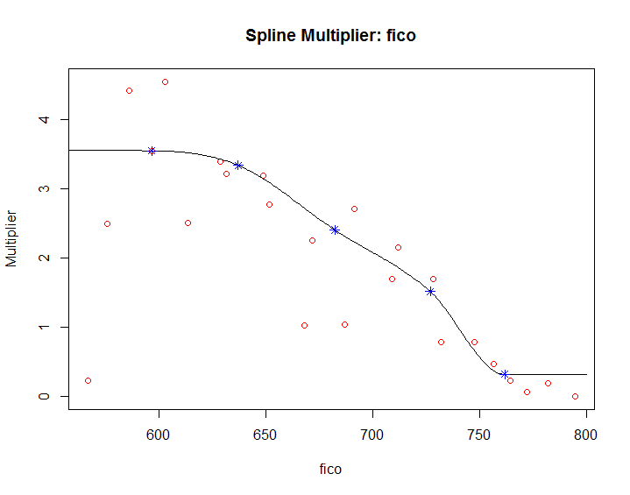
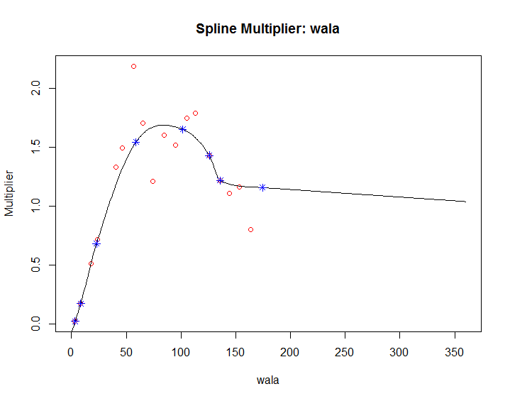
Detail of Default Model v2 Model Multipliers

Slide 17
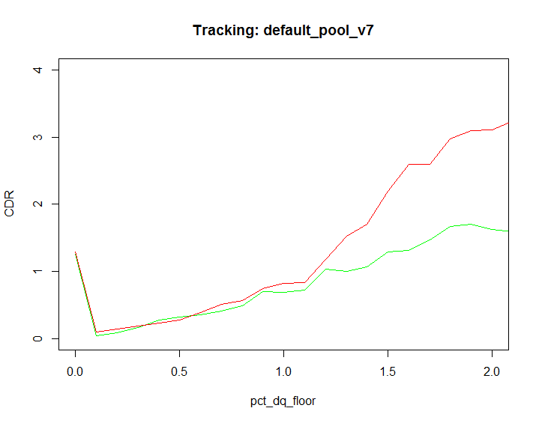
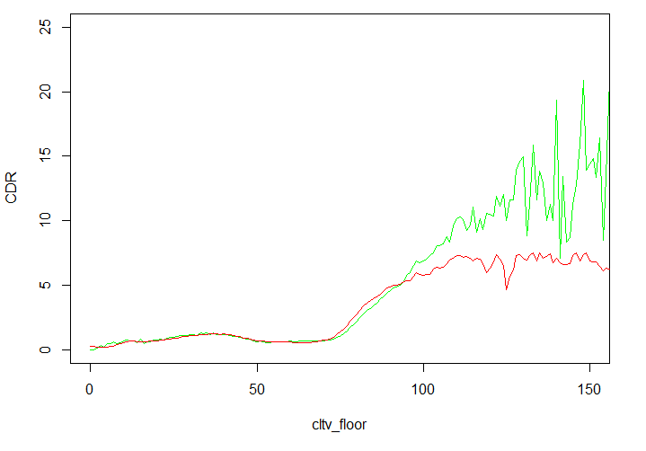
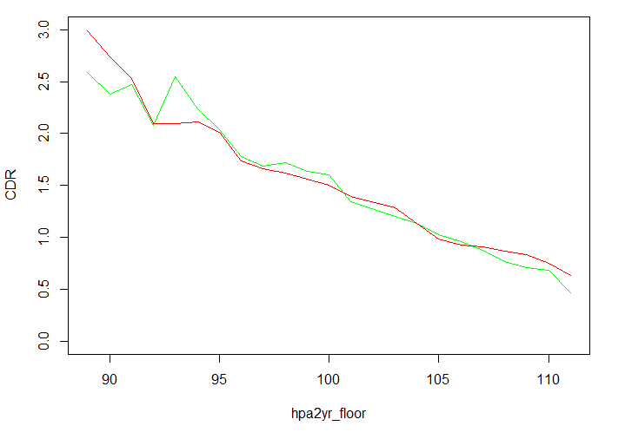
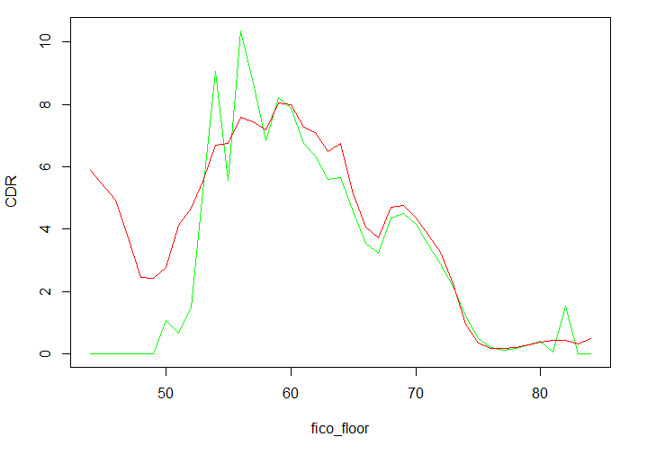
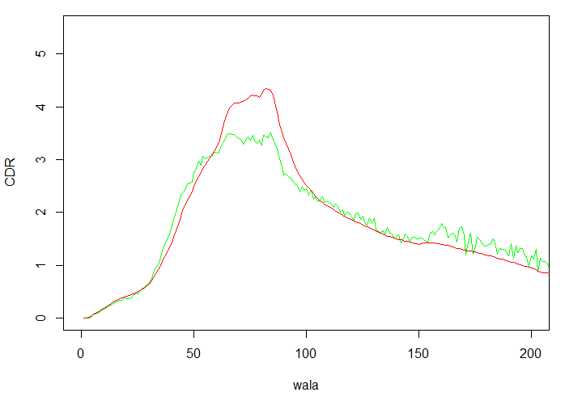
Detail of Default Model v2 Model Tracking for Multipliers
Delinq Percentage
CLTV
Credit Availability
FICO
WALA
Actual
Model

Slide 18
Contents
Model Update Overview
Performance Comparison
Detail of Default Model v2
Appendix

Slide 19
Appendix 1. Max Value of Multipliers
 | Min | Max
pct_dq | 0.700552 | 1.011429
cltv | 0.554088 | 2.126816
hpa2yr | 0.998536 | 1.324714
fico | 0.32096 | 3.561365
wala | 0.020321 | 1.063774
extreme | 0.002528 | 10.79575

Slide 20
Appendix 2. Data Statistics
Description of Default Data
Prepay Data
Pool Level
Delinquency/Default information only available for Freddie pools
~ 352 K pools with data as far back as 2011
30 Day, 60 Day, 90 Day, 120 Day and Repurchased balances are available
Loan Level
No Delinquency/Default information is available
Credit Data
Delinquency/Default information available for Fannie and Freddie loans
~ 40 M loans with data as far back as 1999
Loan Age up to 180
Has indicators for Prepayment, and Default
Excellent coverage for FICO, DTI, CLTV (msa level), Occupancy, etc.

Slide 21
Description of Default Data: Default Definition
Appendix 3. Default Definition
Prepay Data
Pool Level: Default Definition
120 day delinquent loans are removed from the pool
Default balance is reported
Credit Data
Loan Level: Default Definition
180 day delinquent loans are removed from the data and a Zero Balance Code is reported
Revised Credit Data
We must modify the default criteria to match with the Pool data
First time a loan reaches 120 days delinquent, the loan is marked as a default
Default Empirical Formula
MDR (monthly default rate) = default balance / current balance

